Slide 1
MULTILAYER PERCEPTRON
Dr. S. KANNIMUTHU
ASP/CSE/KCE

Slide 2
In Last Module
We saw that while linear models are easy to understand and use
They can only identify straight lines, planes, or hyperplanes.

Slide 3
But!!
Majority of interesting problems are not linearly separable.
Problems can be made linearly separable if we can work out how to transform the features suitably.
In this session, we will instead consider making more complicated networks.

Slide 4
Foundation
The learning in the neural network happens in the weights.
So, to perform more computation it seems sensible to add more weights.

Slide 5
Foundation (Contd..,)
There are two things that we can do:
Add some backwards connections,
so that the output neurons connect to the inputs again
Add more neurons.
The first approach leads into recurrent networks.
These have been studied, but are not that commonly used.
We will instead consider the second approach.
We can add neurons between the input nodes and the outputs, and this will make more complex neural networks,

Slide 6
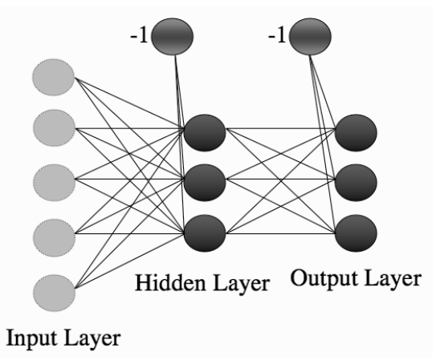
The Multi-layer Perceptron network
consisting of multiple layers of connected neurons.

Slide 7
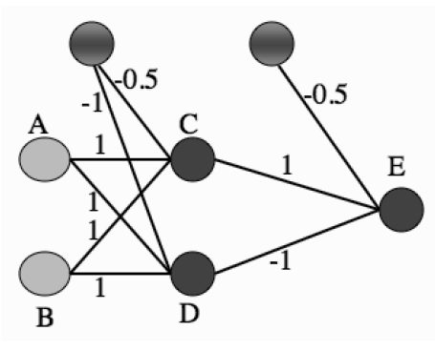
A Multi-layer Perceptron network-XOR
A Multi-layer Perceptron network showing a set of weights that solve the XOR problem.

Slide 8
Example
To check that it gives the correct answers, all that is required is to put in each input and work through the network, treating it as two different Perceptrons
First computing the activations of the neurons in the middle layer (labelled as C and D in Figure)
And then using those activations as the inputs to the single neuron at the output.
As an example, I’ll work out what happens when you put in (1, 0) as an input

Slide 9
Example
Input (1, 0) corresponds to node A being 1 and B being 0.
The input to neuron C is therefore
−1 × −0.5 + 1 × 1 + 0 × 1 = 0.5 + 1 = 0.5.
This is above the threshold of 0, and so neuron C fires, giving output 1.
For neuron D the input is
−1 × − 1 + 1 × 1 + 0 × 1 =1 + 1 = 2
And so it fires, giving output 1.
Therefore the input to neuron E is
−1× − 0.5+1×1+0×1 = 1.5
so neuron E fires.

Slide 10
Example
Checking the result of the inputs should persuade you that neuron E fires when inputs A and B are different to each other, but does not fire when they are the same, which is exactly the XOR function

Slide 11
??
How can we train this network so that the weights are adapted to generate the correct (target) answers?
If we try the method that we used for the Perceptron we need to compute the error at the output.

Slide 12
??
Since we know the targets, so we can compute the difference between the targets and the outputs.
But now we don’t know which weights were wrong: those in the first layer, or the second?
Worse, we don’t know what the correct activations are for the neurons in the middle of the network.
This fact gives the neurons in the middle of the network their name; they are called the hidden layer (or layers), because it isn’t possible to examine and correct their values directly.

Slide 13
THE MLP
the neural network solution proposed by Rumelhart, Hinton, and McClelland, the Multi-layer Perceptron (MLP)
One of the most commonly used machine learning methods around.

Slide 14
Going Fowards
MLP consists of two parts:
working out what the outputs are for the given inputs and the current weights
Updating the weights according to the error,
which is a function of the difference between the outputs and the targets.
These are generally known as going forwards and backwards through the network.

Slide 15
Going Fowards
Same as perceptron, as we did in perceptron
we have to do it twice, once for each set of neurons, and we need to do it layer by layer, because otherwise the input values to the second layer don’t exist.

Slide 16
Bias
Same as in perceptron
Extra input that is permanently set to -1,
and adjusting the weights to each neuron as part of the training.
Thus, each neuron in the network (whether it is a hidden layer or the output) has 1 extra input, with fixed value.

Slide 17
GOING BACKWARDS: BACK-PROPAGATION OF ERROR
Computing the errors at the output is no more difficult than it was for the Perceptron, but working out what to do with those errors is more difficult.
The method that we are going to look at is called back-propagation of error, which makes it clear that the errors are sent backwards throughthe network.
It is a form of gradient descent

Slide 18


Backpropagation
The error function that we used for the Perceptron was
Sum-of-squares error function, which calculates the difference between y and t for each node, squares them, and adds them all together:

Slide 19
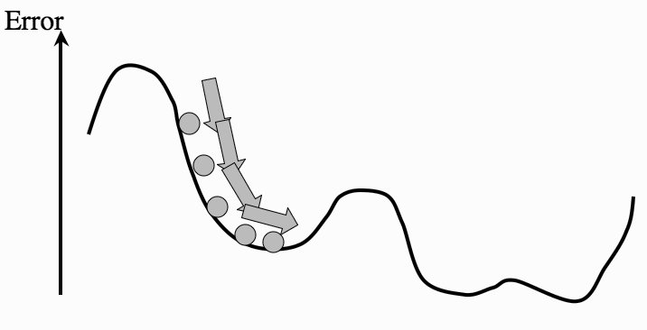
Gradient
The weights of the network are trained so that the error goes downhill until it reaches a local minimum, just like a ball rolling under gravity.

Slide 20
Gradient Descent
Gravity will make the ball roll downhill (follow the downhill gradient) until it ends up in the bottom of one of the hollows.
These are places where the error is small, so that is exactly what we want.
This is why the algorithm is called gradient descent.

Slide 21


Activation Function
we can also use

Slide 22
Backpropoagation
At the output, we’ve computed the errors as the sum-squared difference between the outputs and the targets.
Next, to compute the gradient of these errors and use them to decide how much to update each weight in the network.
We will do that first for the nodes connected to the output layer,
And after we have updated those, we will work backwards through the network until we get back to the inputs again.

Slide 23
Issues
There are just two problems:
for the output neurons, we don’t know the inputs.
for the hidden neurons, we don’t know the targets; for extra hidden layers,
we know neither the inputs nor the targets, but even this won’t matter for the algorithm we derive.

Slide 24
Solution
Use chain rule of differentiation
the chain rule tells us that if we want to know how the error changes as we vary the weights, we can think about how the error changes as we vary the inputs to the weights, and multiply this by how those input values change as we vary the weights.

Slide 25
Chain Rule
This is useful because it lets us calculate all of the derivatives that we want to:
we can write the activations of the output nodes in terms of the activations of the hidden nodes and the output weights, and then we can send the error calculations back through the network to the hidden layer to decide what the target outputs were for those neurons.

Slide 26
The Multi-layer Perceptron Algorithm
Initialisation
initialise all weights to small (positive and negative) random values
Training
repeat:
for each input vector:
Forwards phase:
compute the activation of each neuron j in the hidden layer(s) using:

Slide 27
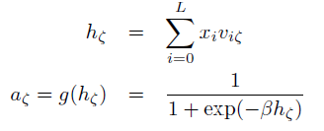
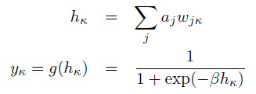
The Multi-layer Perceptron Algorithm
work through the network until you get to the output layer neurons, which have activations

Slide 28


The Multi-layer Perceptron Algorithm
Backwards phase:
compute the error at the output using:
compute the error in the hidden layer(s) using:

Slide 29


The Multi-layer Perceptron Algorithm
Backwards phase:
update the output layer weights using:
update the hidden layer weights using:

Slide 30
The Multi-layer Perceptron Algorithm
* (if using sequential updating) randomise the order of the input vectors so that you don’t train in exactly the same order each iteration
– until learning stops
Recall
– use the Forwards phase in the training section above

Slide 31
Initialising the Weights
MLP algorithm suggests that the weights are initialised to small random numbers
A common trick is to set the weights in the range −1/sqrt(n) < w < 1/sqrt(n), where n is the number of nodes in the input layer to those weights.
If the weights are large, then the activation of a neuron is likely to be at, or close to, 0 or 1 already, which means that the gradients are small, and so the learning is very slow.

Slide 32
Requirements for the Activation function
In order to model a neuron we want an activation function that has the following properties:
it must be differentiable so that we can compute the gradient
it should saturate (become constant) at both ends of the range, so that the neuron either fires or does not fire
it should change between the saturation values fairly quickly in the middle

Slide 33
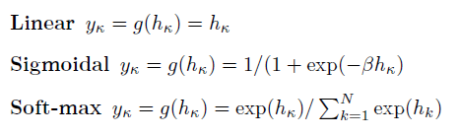
Different Output Activation Functions
Linear
Sigmoid
Softmax

Slide 34
Sequential & Batch Learning
MLP is designed to be a batch algorithm.
All of the training examples are presented to the neural network, the average sum-of squares error is then computed, and this is used to update the weights.
Thus there is only one set of weight updates for each epoch (pass through all the training examples).

Slide 35
Sequential & Batch Learning
This means that we only update the weights once for each iteration of the algorithm
It means that the weights are moved in the direction that most of the inputs want them to move, rather than being pulled around by each input individually.
The batch method performs a more accurate estimate of the error gradient, and will thus converge to the local minimum more quickly

Slide 36
Sequential & Batch Learning
In sequential version, where the errors are computed and the weights updated after each input.
This is not guaranteed to be as efficient in learning, but it is simpler to program when using loops, and it is therefore much more common.
Since it does not converge as well, it can also sometimes avoid local minima, thus potentially reaching better solutions.

Slide 37
Avoid Local Minima
Use Momentum to achieve global minima so as to avoid local minima.

Slide 38
Stochastic Gradient Descent
Use just one piece of data to estimate the gradient at each iteration of the algorithm, and to pick that piece of data uniformly at random from the training set.
So a single input vector is chosen from the training set, and the output and hence the error for that one vector computed, and this is used to estimate the gradient and so update the weights.

Slide 39
Stochastic Gradient Decent
A new random input vector (which could be the same as the previous one) is then chosen and the process repeated. This is known as stochastic gradient descent.
This can be used for any gradient descent problem, not just the MLP.
It is often used if the training set is very large, since it would be very expensive to use the whole dataset to estimate the gradient in that case.

Slide 40
A recipe for using the MLP
Select inputs and outputs for your problem
Normalise inputs
Split the data into training, testing, and validation sets
Select a network architecture
Train a network
Test the network

